Slide 1
Karisma v4
Diary
Reception
MITs
Kiosk
Reports
Search
Forge
Going Forward

Slide 2
Karsima v4
The latest version of Karisma presents a simplified, touch-friendly interface that puts everything you need for your workflow in the one place with quick access.

Slide 3
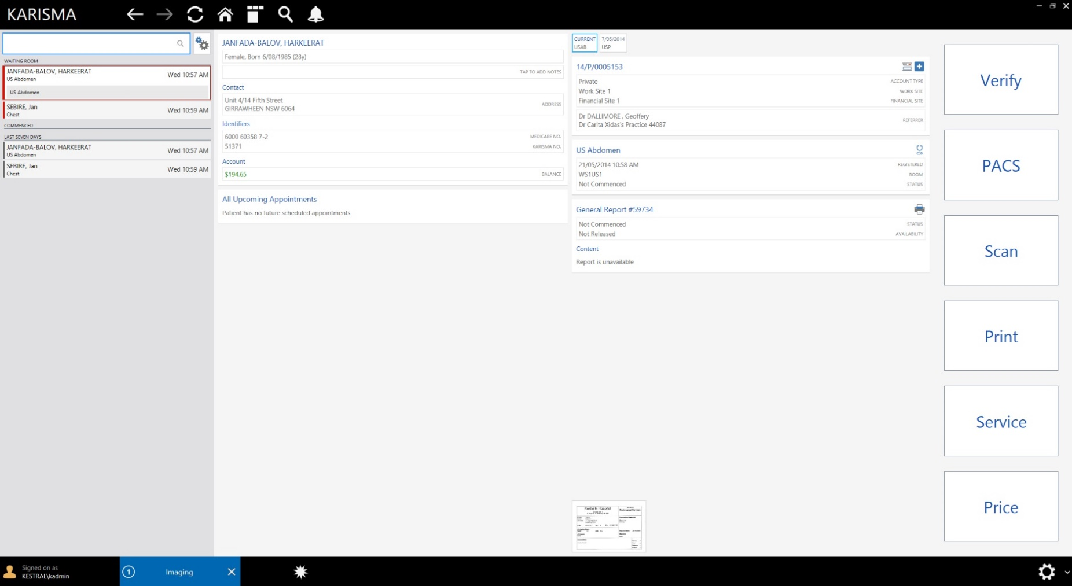

Slide 4
Diary
The Karisma v4 diary offers all of the convenience you expect from Karisma – plus you can now open multiple diaries in the same screen.

Slide 5
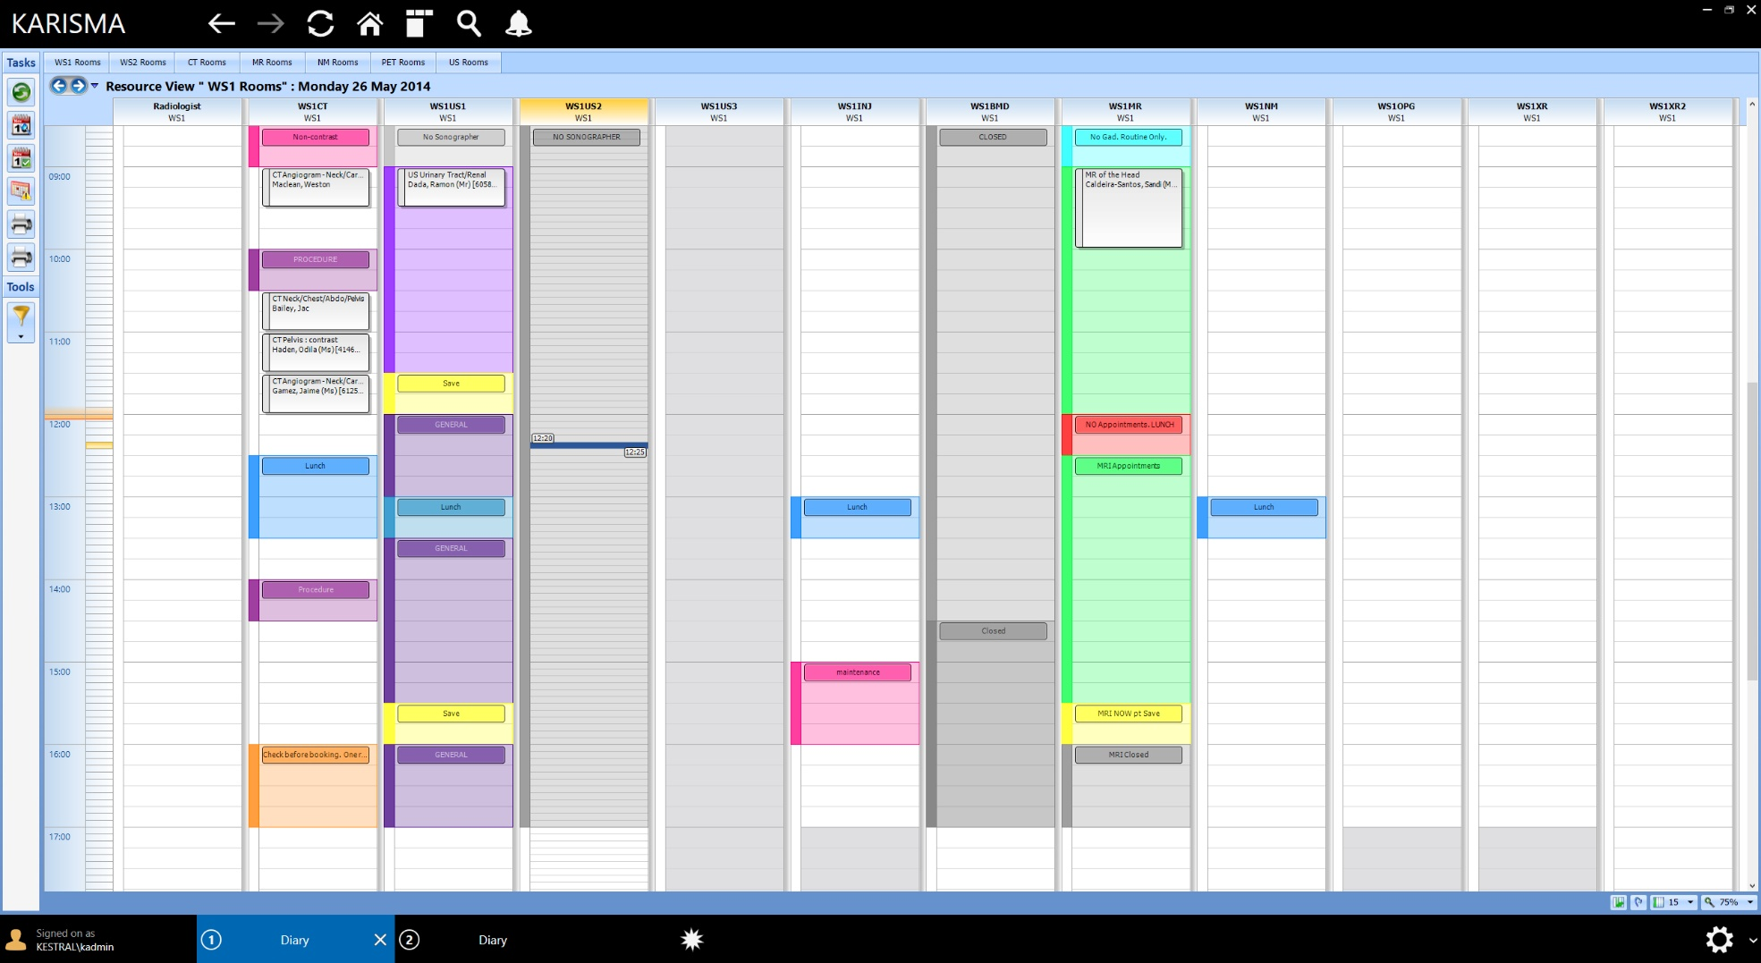

Slide 6
Reception
The Reception screen brings together all of the tasks usually performed at reception – such as scheduling, pricing, scanning and validation. Everything is accessible with a simplified interface that’s easy to learn and use

Slide 7
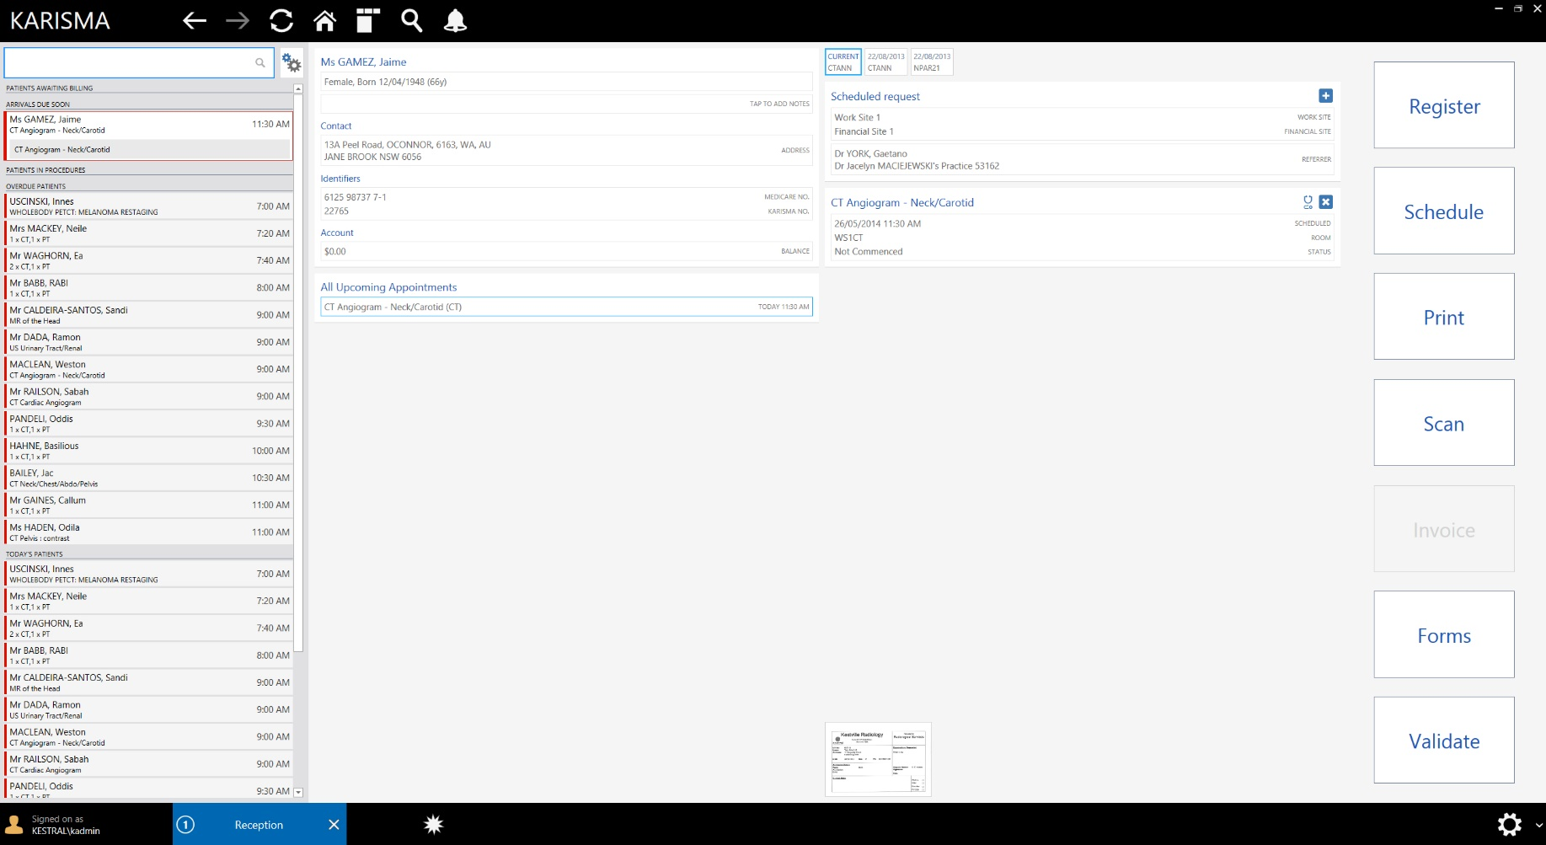

Slide 8
Medical Imaging Technologists
With Karisma v4’s innovative interface specially designed for touch screens, tablets such as the Microsoft Surface mean increased mobility for MITs throughout the organisation.

Slide 10
Patient Reception Kiosk
An airport style kiosk allows patients to perform their own check-in and arrivals. Booking reminders with embedded barcodes add another dimension of convenience that will improve customer service.

Slide 11
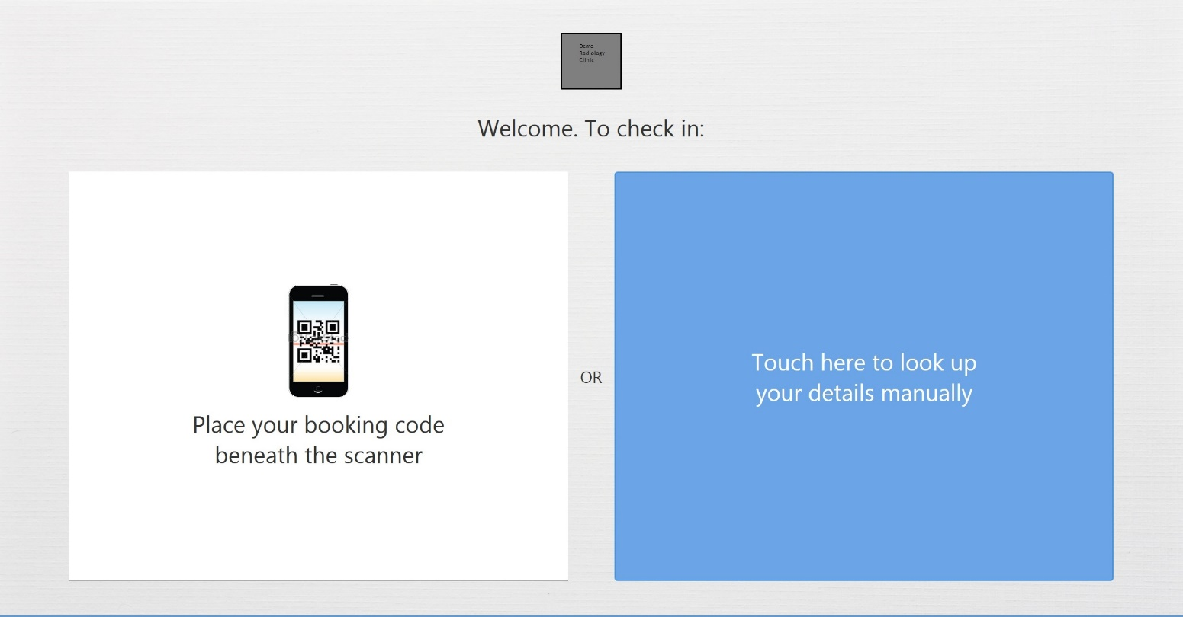

Slide 12
Management/Financial Reports
Powerful, commercial level reports are all a part of the Karisma product. Karisma provides quick access to important business information integrated with workflow – including referrer ‘heatmaps’.

Slide 13
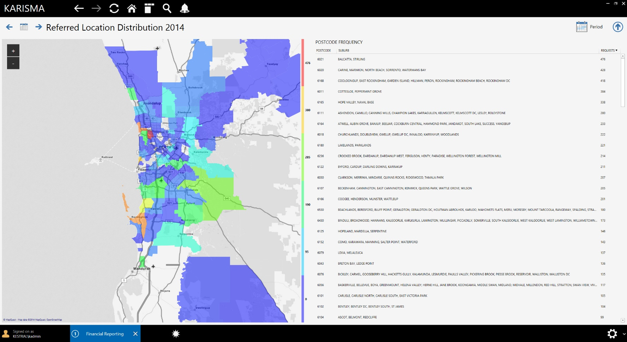

Slide 14
Search “Carcinoma”
The ‘spotlight’ style search built into Karisma v4 allows users to search across concepts for results. Contact names, address information, report content, services and more are all included in search queries.

Slide 15
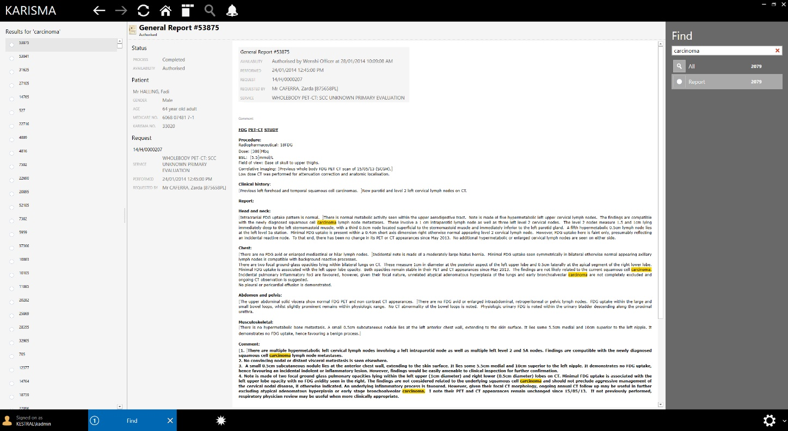

Slide 16
Search “Smith”
For example, using the new search capabilities, the word Smith is found across patient names, practitioner names and report content – with one click access to filter and even edit results.

Slide 17
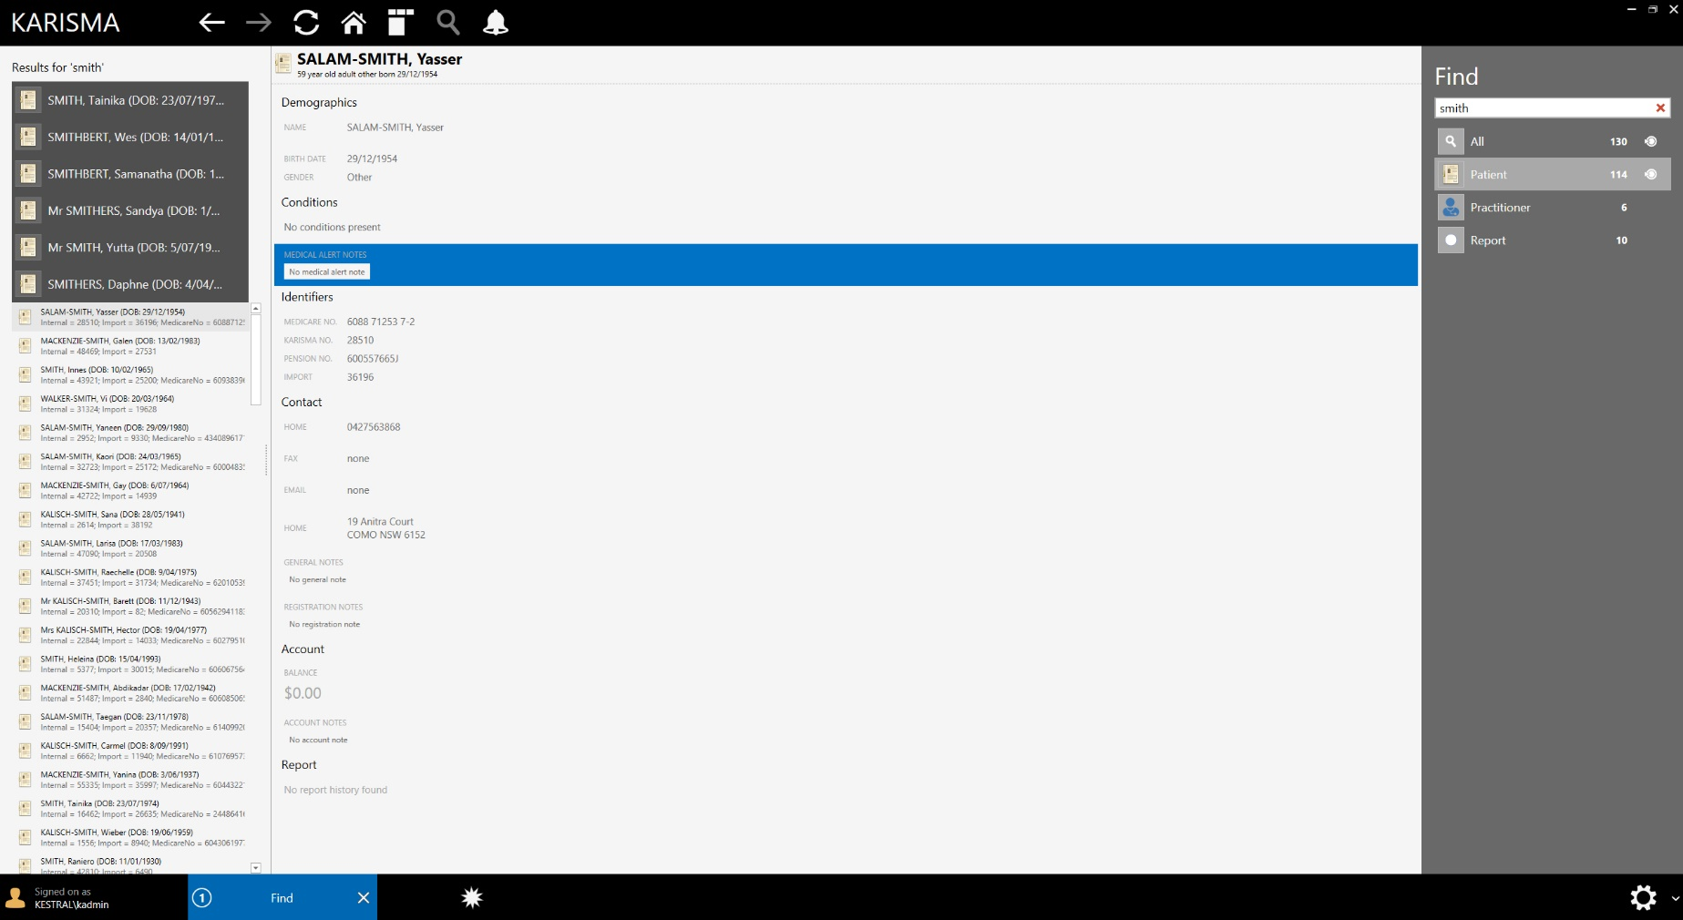

Slide 18
The Forge Family (2009 – 2014)
Forge is a multi product platform which allows the rapid development of enterprise systems. Kestral has been working on Forge since 2009 to provide a solid foundation to all of our products. We believe in long term reinvestment in technology.

Slide 19
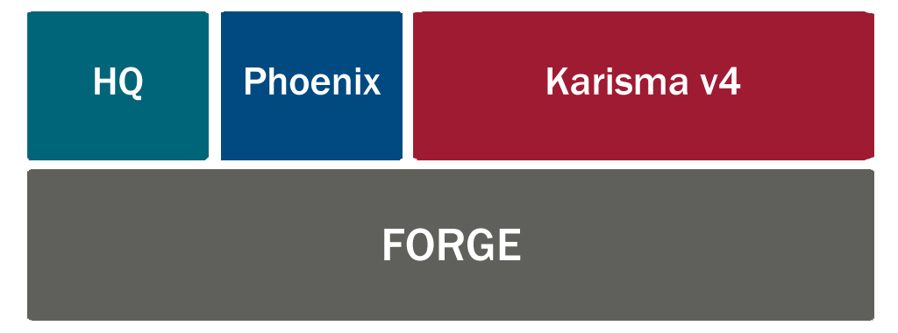

Slide 20
Going Forward
With the new Forge platform :
- Rapid Development
- Innovate
- Keep Up To Date

Slide 21
Karisma Version 4:
Designed to keep Kestral customers ahead of the curve.

